Slide 1
Highlands Neighborhood Association
2022 Annual Meeting
November 3, 2022

Slide 2
Agenda
State of the Neighborhood
What is a “neighborhood association”?
Issues for discussion
Traffic/Safety committee update
Treasurer’s Report
Officer Elections

Slide 3
What is a “neighborhood association”?
Neighborhood Associations are affiliated with the City of Boise through its planning process
Neighborhood Associations interface with the City on issues pertaining to neighborhood planning, development and improvement
NAs also provide a vehicle to voice concerns to the City as a consolidated voice, with the goal of making/planning a better neighborhood
NAs prepare Neighborhood Reinvestment Grants and other applications (mini grants for annual picnic, dog waste removal, administrative expenses, etc.)
According to our articles of association, the purposes of the HNA are, through the executive committee, to “facilitate dissemination of information to its members, and to consider and deal with problems and issues of the membership of the Association”

Slide 4
What is a “neighborhood association”?
Planning and development frequently contacts NAs with regard to development applications in the neighborhood
We live in the Highlands Neighborhood association, which is essentially the traditional “Highlands”, Hackberry, Hackberry North, El Pelar, Highlands Cove and multi-family housing units on Bogus Basin Road and HVD.
For more information, please refer to the Highlands Neighborhood Plan posted on our website.

Slide 5
https://highlandsneighborhood.weebly.com/

Slide 7
Issues for Discussion
Picnic
HVD speed mitigation
Community Development Tracker
Other areas of concern?

Slide 8
Picnic
We had a wonderful picnic the second day of school August 18
HNA provided food and drinks
Great turnout – the new school principal and Lisa Sanchez met neighbors
May consider timing with first day of school to avoid scheduling conflicts

Slide 9
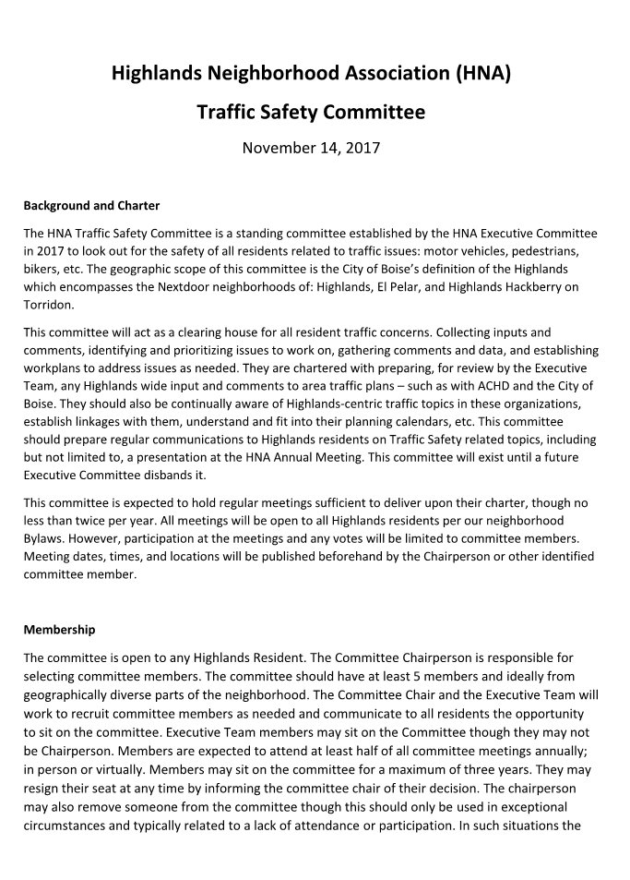
Traffic/Safety committee update
Clearinghouse for all resident traffic concerns
Reports to the Executive Committee
Committee Chairman selects at least 5 members
Meetings are open to any HNA resident (Bylaws Article 5C)

Slide 10
Vacant
Dave Groom
Jolie Strohmeyer
Dave Fotsch

Slide 11
Past Activities
Meetings with City & ACHD
Traffic priorities for ACHD IFYWP
P&Z hearings for development
Highlands View Drive Survey (July/August 2018)
Many voices on this subject from “do nothing” to “do everything”
65% of homes (75 of 116) responded to survey (67% occupied homes)
Conclusions
> 65% support need for speed mitigation
> 56% support need for pedestrian safety mitigation
> 68% said candles were not effective
> 90% said they expected to be involved in future decision making

Slide 12
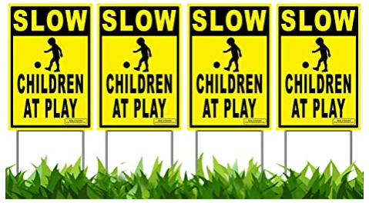
2022 Current Activities
Traffic issues on HVD, E Braemere & Hearthstone
Speeding & two rollovers in 2020 (HVD and E Braemere)
Boise PD presence in the neighborhood to police speeding
HVD street walks with ACHD
Pilot study proposal
Highlands Cove mitigation funds are available
Yard sign program (~100 signs available)
Contact Jeff Bradley

Slide 13
2022 Current Activities
Other reminders
1 committee vacancies (Area 1: Hackberry)
Send in your comments/concerns
Recommend also sending any comments to ACHD TellUs website (photos can be attached): http://achdidaho.org/AboutACHD/contactUs.aspx

Slide 14
HVD Speed Mitigation
ACHD/Precision issued a traffic calming report July 20, 2022
We (the HNA) requested this study seeking traffic calming/engineering solutions to (1) encourage drivers to drive 20 mph along HVD, (2) improve safety for pedestrians and cyclists and (3) provide improve safety for students waiting for the school bus.
The intended outcome of this project is to find traffic calming measures that have a measurable effectiveness of calming traffic along HVD and to implement those measures in a permanent manner:
Mini Roundabout at Parkhill
Bulbout/Improve Radius at Wyndemere
Pass-through Chokers
Chokers will require support/concurrence from the adjacent home owners due to the resulting in loss of parking

Slide 16
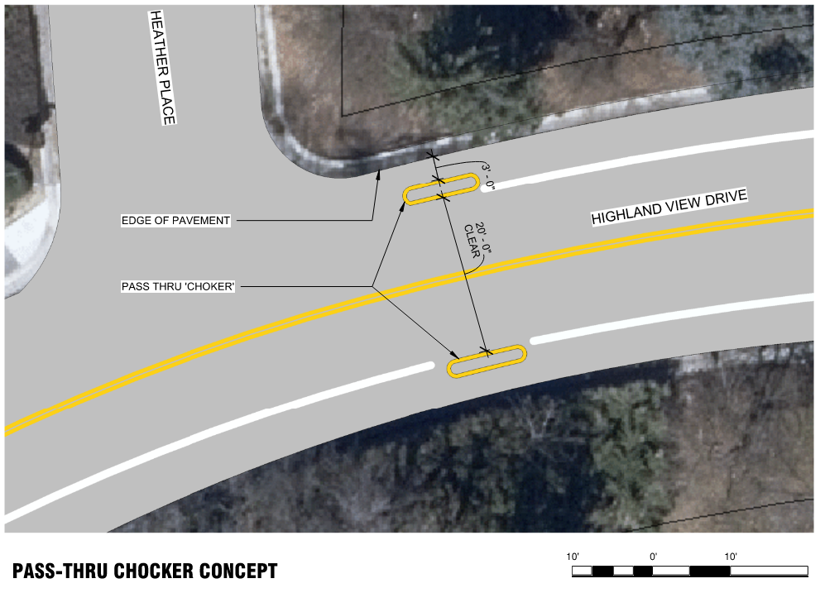

Slide 17
HVD Speed Mitigation – Next Steps
Solicit feedback on the proposed temporary traffic calming measures, including working with affected residents to gain concurrence for loss of parking to accommodate temporary traffic calming applications.
Working group held meeting 9/12/2022 – initial “feedback” meeting
Need to obtain concurrence from homeowners impacted by chokers
Expect ACHD to hold meeting with neighborhood early 2023 – primary “feedback” meeting
Implementation of temporary traffic calming measures
ACHD looking for “funding” to make happen, hopefully Spring 2023
ACHD requires these measures be installed as temporary installations for a minimum 12-18 month pilot period in order to determine if the traffic calming measures perform as intended.
Data collection and follow up studies
Follow up public information meetings to solicit feedback on temporary applications from HNA and residents and consideration of future permanent installations

Slide 18
Community Development Tracker
Community Development Tracker | City of Boise
“To make it easier to understand what developments are happening in the city, where they are in the planning process, and how you can be involved, the City of Boise has launched a Community Development Tracker.”
“The tracker allows you to view developments across the city and find useful information about it. This tool is still in the testing stages and we look forward to your feedback to ensure it is user friendly and informative.”

Slide 19
Treasurer’s Report

